Slide 1
title
Resource Placement and Assignment
- COIN in Multi-Objective scenarios -
Notes:
Distribuição e Disposição de Recursos

Slide 2
contents
Motivation
What (problem)
Why COIN
How (experiment)
How (extensions)
Expected Results
Appendix
Notes:
COIN concepts along the text.

Slide 3
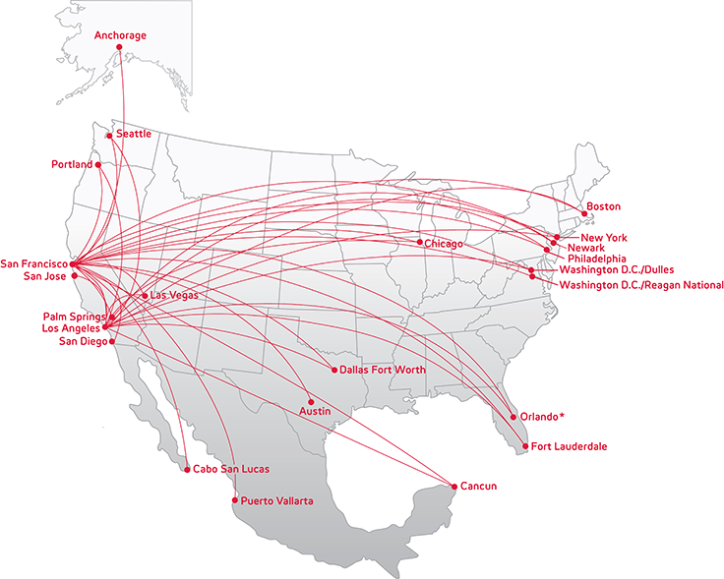
motivation
MOP
Real-World problems from a different perspective.
Problems with two or more objective functions whose values must be simultaneously optimized.
engineering, financial, logistics, personal
Cost vs. Confort
Price vs. Convenience
Notes:
Satisfy all the objectives … in general conflicting…
Complex and large search space AND Time expensive

Slide 4
motivation
MOP characteristics
Makes mathematical modeling easier.
Optimum solution ≠ single answer, but a set of trade-off points.
Pareto dominance
Multi-Objective function
Pareto Dominance
Pareto front
Pareto Optimal set
Notes:
O problema vai sendo construído ao longo da apresentação.
Ao invés de construir uma equacao única que engloba multiplos objetivos (facilita a modelagem) … eu tento max/min cada um deles separadamente e encontrar uma solucao.
an higher-level decision maker has to choose a solution from this set that represents the best trade-off with respect to the multiple conflicting objectives and his preferences
x é o meu vetor de variáveis de decisão
xi não é pior que vi em todos os objetivos
xi é melhor que vi em pelo menos 1 objetivo
Minimize the distance of the Pareto front produced by the
algorithm with respect to the true Pareto front if it is known
I
Maximize the spread of solutions found, so that we can have a
distribution of vectors as smooth and uniform as possible.
I
Maximize the amount of elements of the Pareto optimal set
found.

Slide 5
WHAT: problem
Resource Placement and Assignment
A domain with considerable areas for resource extraction needs to address processing units in such a way that optimizes its operational costs and production of collected resources.
Notes:
Should the problem be extended here with: “and others subjectives objectives (non-explict)”?

Slide 6
WHAT: problem
Resource Placement and Assignment
A domain with considerable areas for resource extraction (g) needs to address processing units (u) in such a way that optimizes its operational costs (f₁) and production of collected resources (f₂).
Decision Making
Bi-Objective or Tri-Objective
st: multiples objectives and scenario extensions
different applications for the same problem
(ahead)

Slide 7
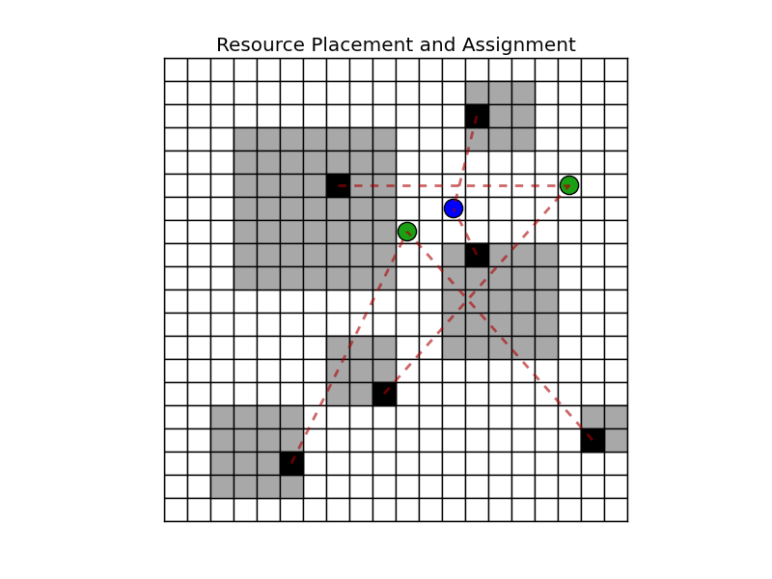
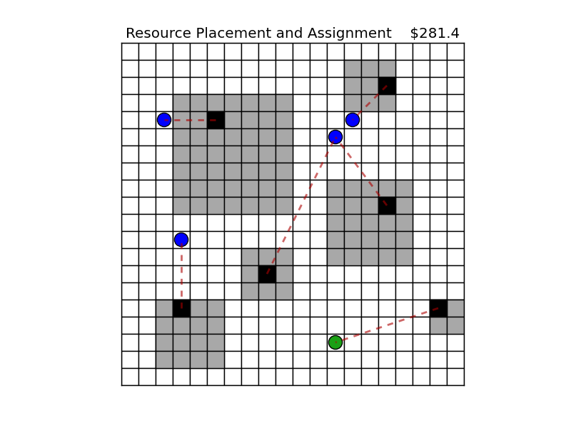
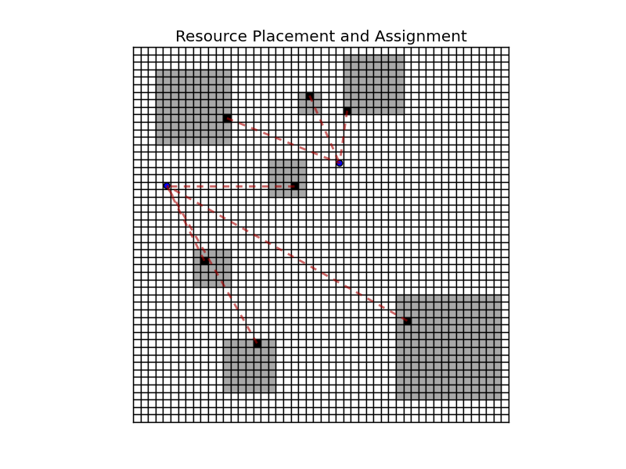



WHAT: problem
Resource Placement and Assignment
1
2
area
gateway
unit (small)
unit (large)
3

Slide 8
WHAT: problem
Resource Placement and Assignment
Bi-Objective
or
Constraints
Decision Variables

Slide 9
WHAT: problem
Resource Placement and Assignment
State of the Art
?
(Acho interessante para o trabalho final escrito .... Não agora! ... Mas já deixo assinalado aqui.)
Autorouter: smartplant lay-out
Notes:
ICIEA approach

Slide 10
WHY COIN
Resource Placement and Assignment
REASON
Problem can be understood by the collective.
Complex scenarios, hard for computer.
Some (extra/hidden) objectives are hard to comprehend and to work
Take the advantage of human perception, subjectivity and agility.
Intelligence from participatory actions of many individuals.
(?) Collective reference points or hints to a narrow representation.
Notes:
Esse é o Slide + importante…
Apreensível pela Coletividade: visual, intuitive
NP-Hard
Muitos Objetivos … além de serem de difícil compreensão
.
Cenários podem ser muito mais complexos que esse (mais restrições, mais objetivos, …)
Apoiar na tese de que o coletivo supera o especialista
Ref points ou Hints (regiões do mapa) para orientar a busca e a frente de soluções ótimas.

Slide 11
WHY COIN
Resource Placement and Assignment
EXPECTED BENEFITS
Better answers (trade-off).
Narrow Pareto-optimal front.
Get individual characteristics from the participants
Quicker resolution (iteration).
Narrow Pareto-optimal front.
Non-obvius and Non-explicit objectives appreciation. (Subjectivity)
(or) Learning from collectivity
Notes:
ROGÉRIO (ou eu, veja como prefere!)
from collectivity
from collectivity
Eu falo o quadro cinza. Coringa... Se houver interesse eu falo, se não, deixo passar.

Slide 12
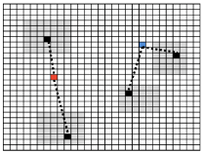
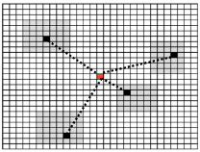

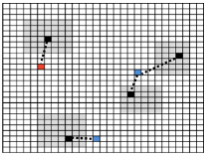
How (experiment)
Resource Placement and Assignment
choose
selected
or
result
EMOA
Analysis
Comparison
light local
search
Notes:
ICIEA approach

Slide 13
How (experiment)
How to Aggregate?
Individual
Cluster
Average
Regions
Resource Placement and Assignment
How to break?
Every “x” generations
Best ind.
Best and Medium ind.
choose
selected
or
result
EMOA
Analysis
Comparison
GA (mono)
NSGA-II
SMS EMOA
ICIEA
light local
search
How to aggregate?
Utility Function
Average
Notes:
ICIEA approach

Slide 14
How (experiment)
Resource Placement and Assignment
ICIEA* – Interactive Collective Intelligence Evolutionary Algorithm
Evolutionary Algorithm (GA)
NSGA-II or SPEA or SMS EMOA
Interactive Approach/Improvement (small blocks)
Find-Fix-Verify
Incentive engine (goals)
Playful spirit (gamification)
Alienation of labor
Crowdsourcing: straight
Parallel job and Synch
Characteristics analysis
Notes:
ICIEA approach
Short scope

Slide 15
How (today)
Resource Placement
Quantitative Results
Hypervolume
Coverage of two sets
Notes:
Besides that, Luis asked me to
improve the functions
Improve the constraints.
I will work on the convergence and diversity of sum(optimal-200)

Slide 16
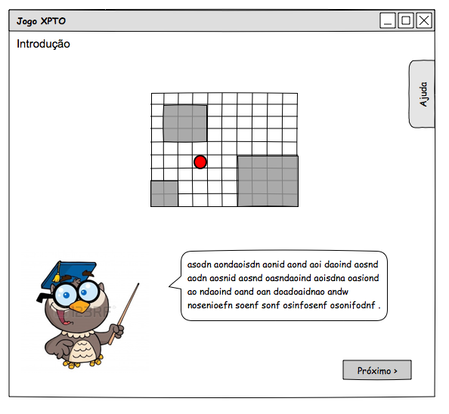
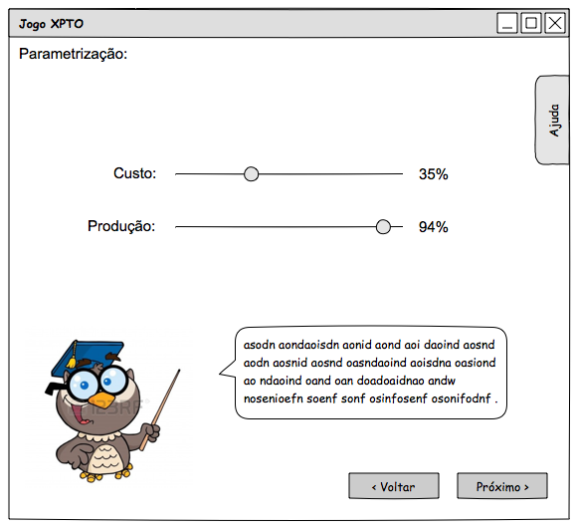
How (extensions)
Resource Placement and Assignment
Wireframe

Slide 17
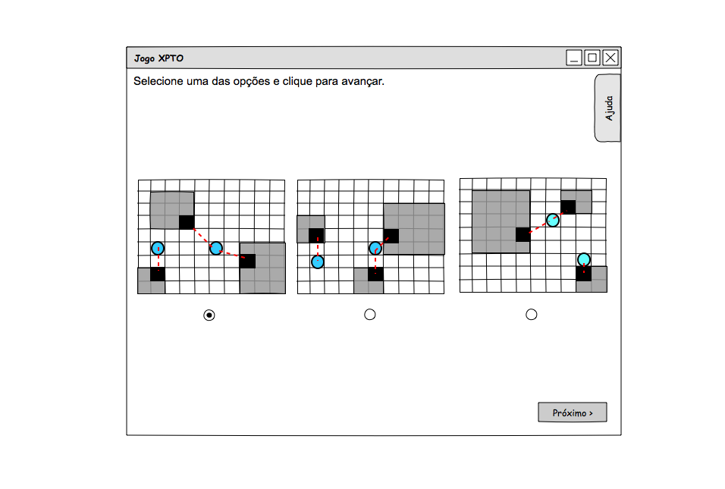
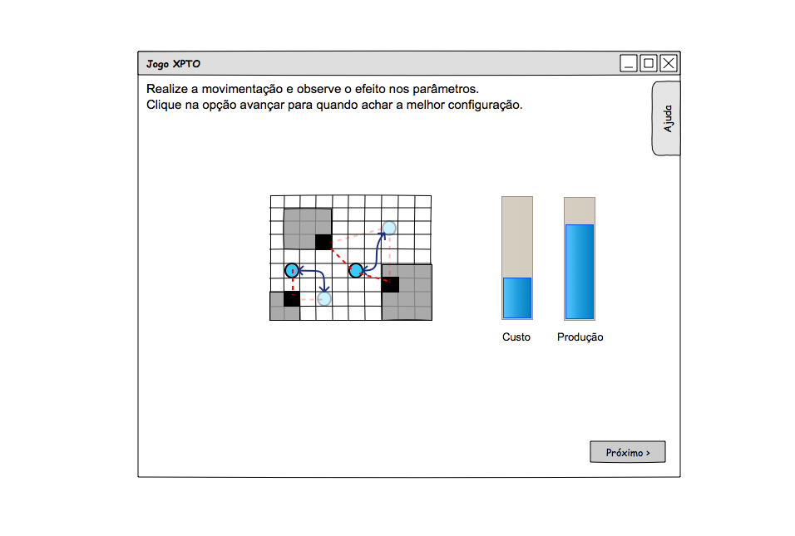
How (extensions)
Resource Placement and Assignment
Wireframe
Interactive + FFV + gamification + incentive goals

Slide 18
Summary
Resource Placement and Assignment
(for this experiment)
Better answers (trade-off).
Quicker resolution (iteration).
Characteristics analysis

Slide 19
How (extensions)
Resource Placement and Assignment
FUTURE
Hint and Reference Point
Relevant Areas in Pareto-optimal front
Hard Search
Relevant Regions in the “world”
Non-Obvious and Non-Explicit objectives achievement
(e.g.: creativity, risk, robustness, ...)
Learning from collectivity
More Complex Scenarios
Strategy: feedback from users
Notes:
Coringa…. Se tiver tempo eu falo.

Slide 20
Thank You!

Slide 21
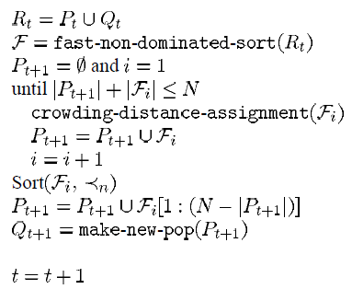
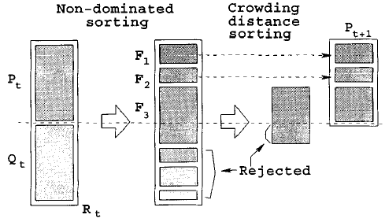
Appendix
Resource Placement and Assignment
NSGA-II R-NSGA-II
New rank in the front based on the reference point.
New crowding distance values based on the rank.
COIN aggregation
“aggregation”: include
“aggregation”: over
Notes:
NSGA main criticisms:
High computational complexity of nondominated sorting
describe a fast nondominated sorting approach which will require N^2 computations instead of N^3
domination count np, the number of solutions which dominate the solution , and 2) Sp, a set of solutions that the solution dominates.
Ele faz um rank de frentes de Pareto (em camadas)
Lack of elitism
Need for specifying the sharing parameter
Crowding dist
c. Crowded-Comparison Operator: The crowded-compar- ison operator ( ) guides the selection process at the various stages of the algorithm toward a uniformly spread-out Pareto- optimal front. That is, between two solutions with differing nondomination ranks, we prefer the solution with the lower (better) rank.
NSGA-II
O GRANE LANCE ESTA AQUI .... Na juncao dos conjuntos....
R-NSGA-II
Step 1: For each reference point, the normalized Euclidean distance of each solution of the front is calculated and the solutions are sorted in ascending order of distance. This way, the solution closest to the reference point is assigned a rank of one.
Step2: Aftersuchcomputationsareperformedforallrefer- ence points, the minimum of the assigned ranks is as- signed as the crowding distance to a solution. This way, solutions closest to all reference points are assigned the smallest crowding distance of one. The solutions hav- ing next-to-smallest Euclidean distance to all reference points are assigned the next-to-smallest crowding dis- tance of two, and so on. Thereafter, solutions with a smaller crowding distance are preferred.
Step 3: To control the extent of obtained solutions, all solu- tions having a sum of normalized difference in objec- tive values of ε or less between them are grouped. A randomly picked solution from each group is retained and rest all group members are assigned a large crowd- ing distance in order to discourage them to remain in the race.

Slide 22
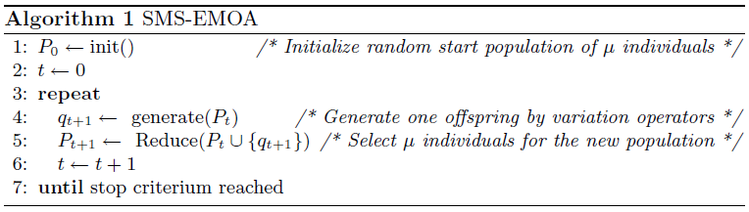
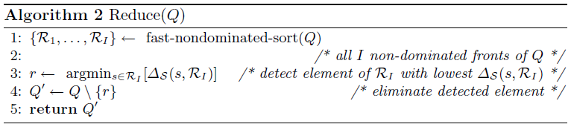
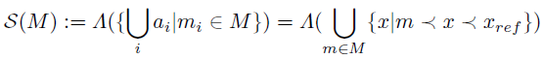
Appendix
Resource Placement and Assignment
SMS-EMOA
“aggregation”: include
“aggregation”: over
Notes:
NSGA main criticisms:
High computational complexity of nondominated sorting
describe a fast nondominated sorting approach which will require N^2 computations instead of N^3
domination count np, the number of solutions which dominate the solution , and 2) Sp, a set of solutions that the solution dominates.
Ele faz um rank de frentes de Pareto (em camadas)
Lack of elitism
Need for specifying the sharing parameter
Crowding dist
c. Crowded-Comparison Operator: The crowded-compar- ison operator ( ) guides the selection process at the various stages of the algorithm toward a uniformly spread-out Pareto- optimal front. That is, between two solutions with differing nondomination ranks, we prefer the solution with the lower (better) rank.
NSGA-II
O GRANE LANCE ESTA AQUI .... Na juncao dos conjuntos....
R-NSGA-II
Step 1: For each reference point, the normalized Euclidean distance of each solution of the front is calculated and the solutions are sorted in ascending order of distance. This way, the solution closest to the reference point is assigned a rank of one.
Step2: Aftersuchcomputationsareperformedforallrefer- ence points, the minimum of the assigned ranks is as- signed as the crowding distance to a solution. This way, solutions closest to all reference points are assigned the smallest crowding distance of one. The solutions hav- ing next-to-smallest Euclidean distance to all reference points are assigned the next-to-smallest crowding dis- tance of two, and so on. Thereafter, solutions with a smaller crowding distance are preferred.
Step 3: To control the extent of obtained solutions, all solu- tions having a sum of normalized difference in objec- tive values of ε or less between them are grouped. A randomly picked solution from each group is retained and rest all group members are assigned a large crowd- ing distance in order to discourage them to remain in the race.

Slide 23
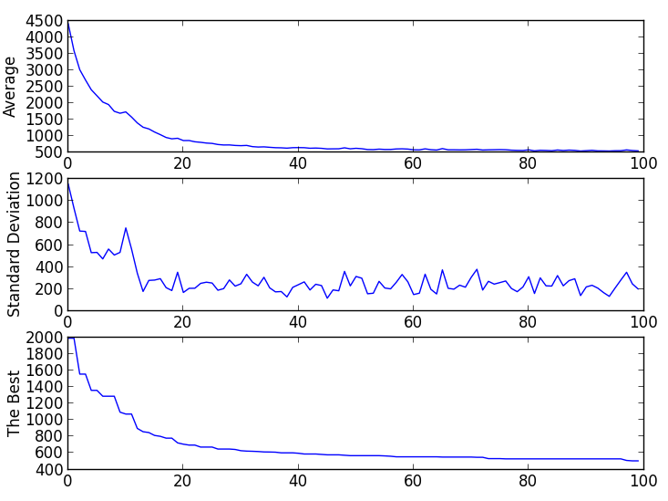
Appendix
Resource Placement and Assignment
IMAGE Results
Mono-Objective ($cost)
Convergence
Around 100 gen.

Slide 24
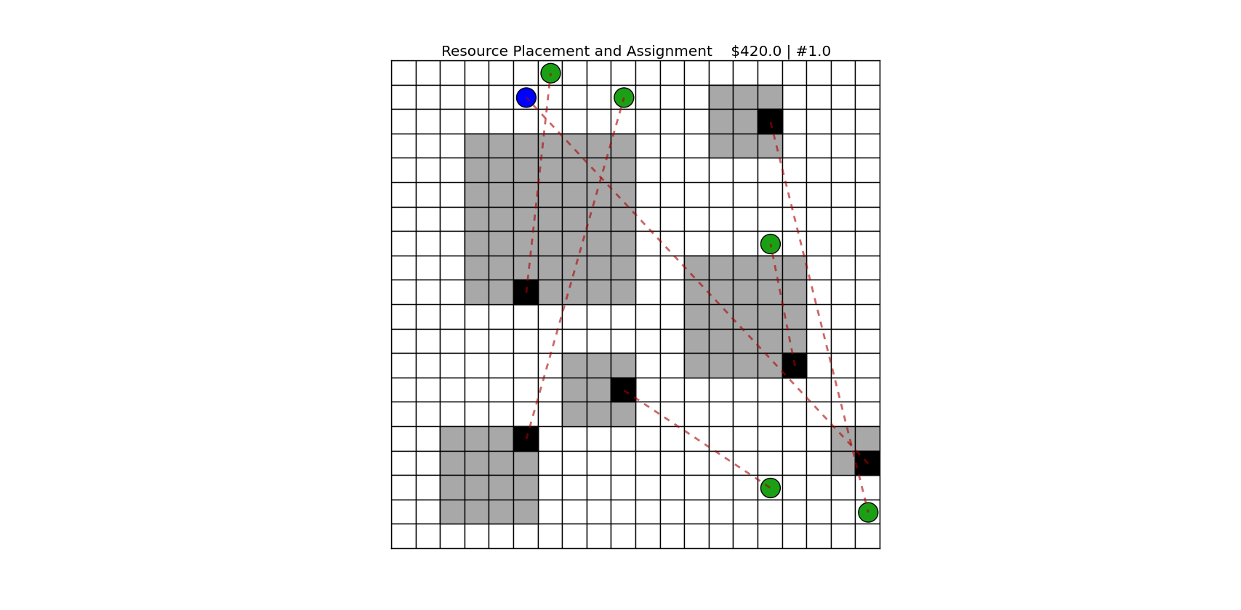
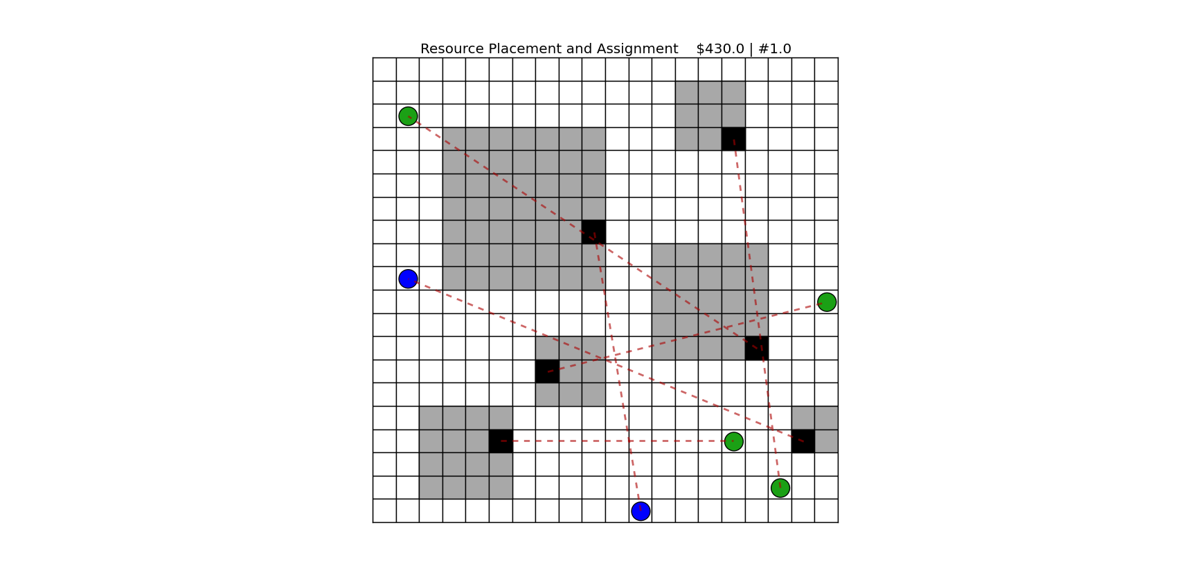
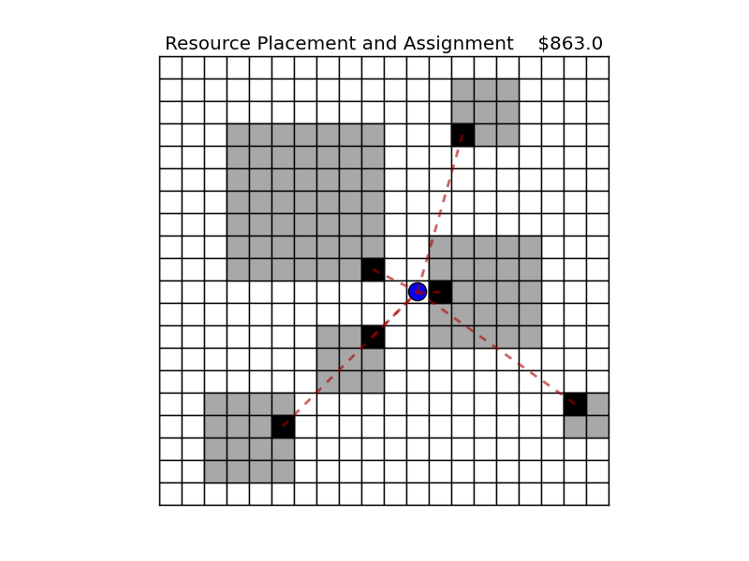
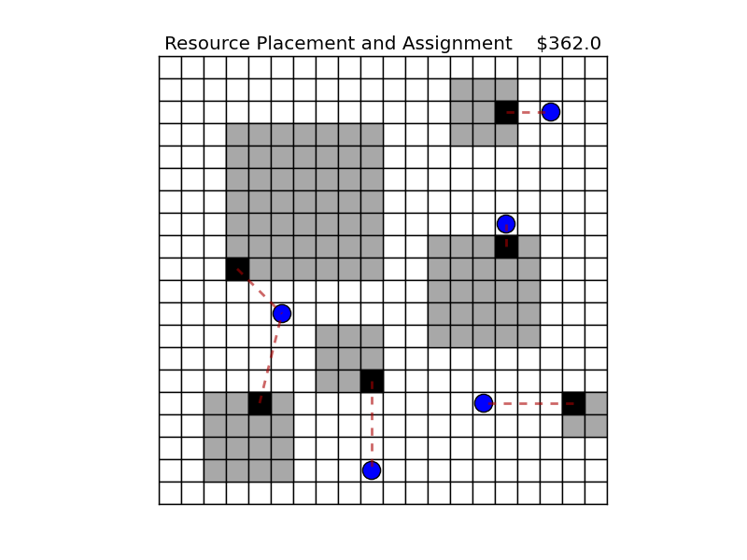
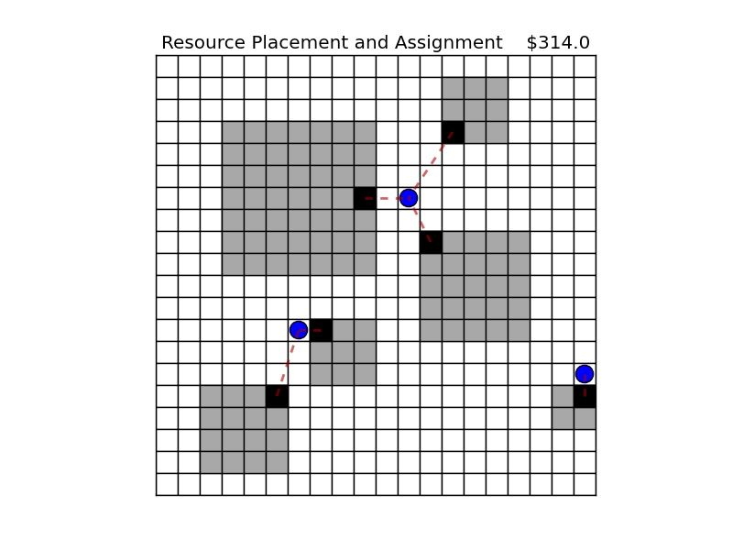
Appendix
Bad: pure random
Resource Placement
IMAGE Results
Mono-Objective ($cost)
Answers

Slide 25
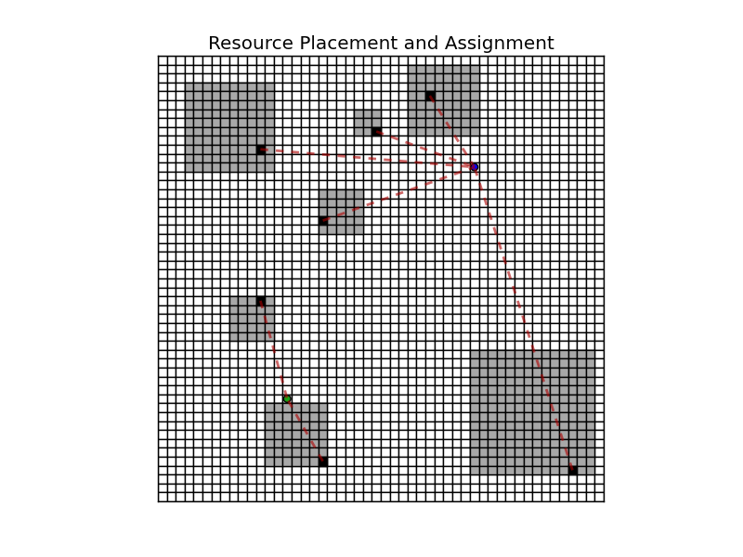
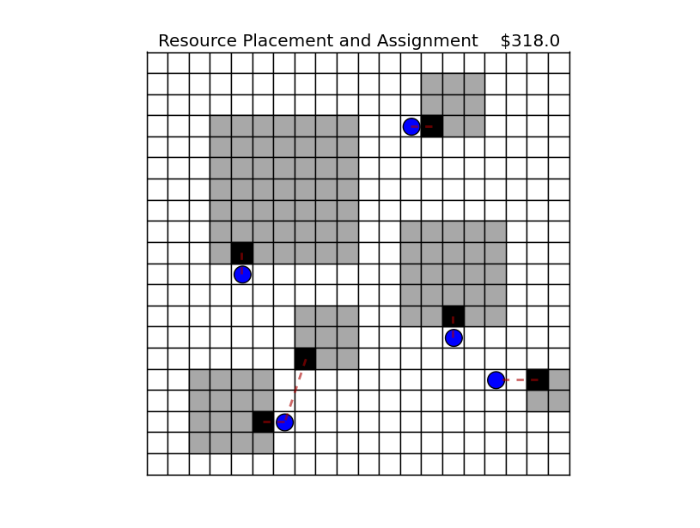
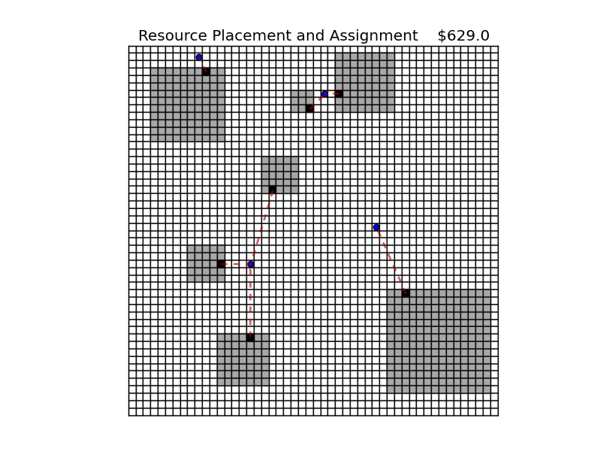
Appendix
Resource Placement
IMAGE Results
Mono-Objective ($cost)
Answers

Slide 26
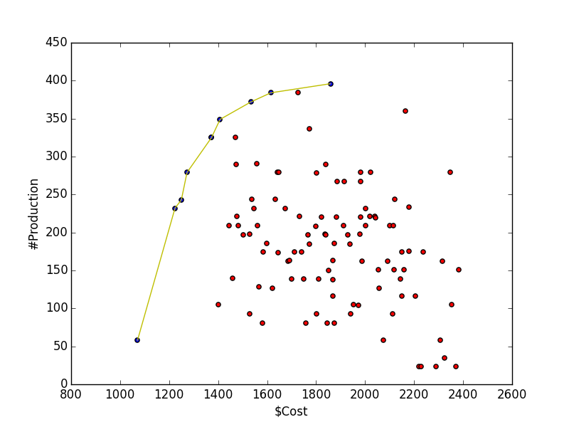
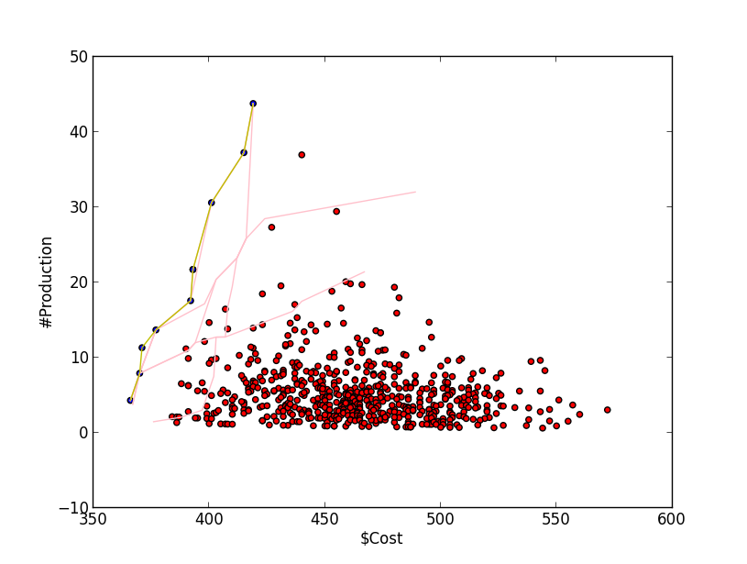
Appendix
Resource Placement and Assignment
IMAGE Results
Bi-Objective
Progress

Slide 27
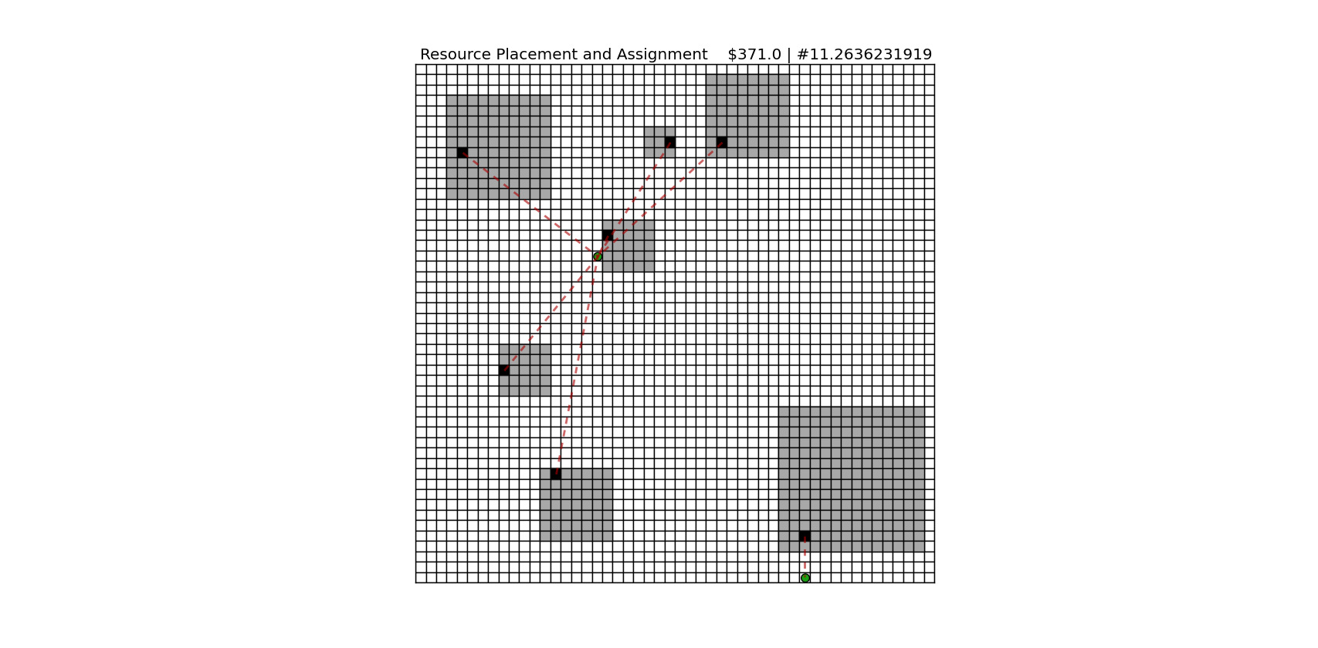
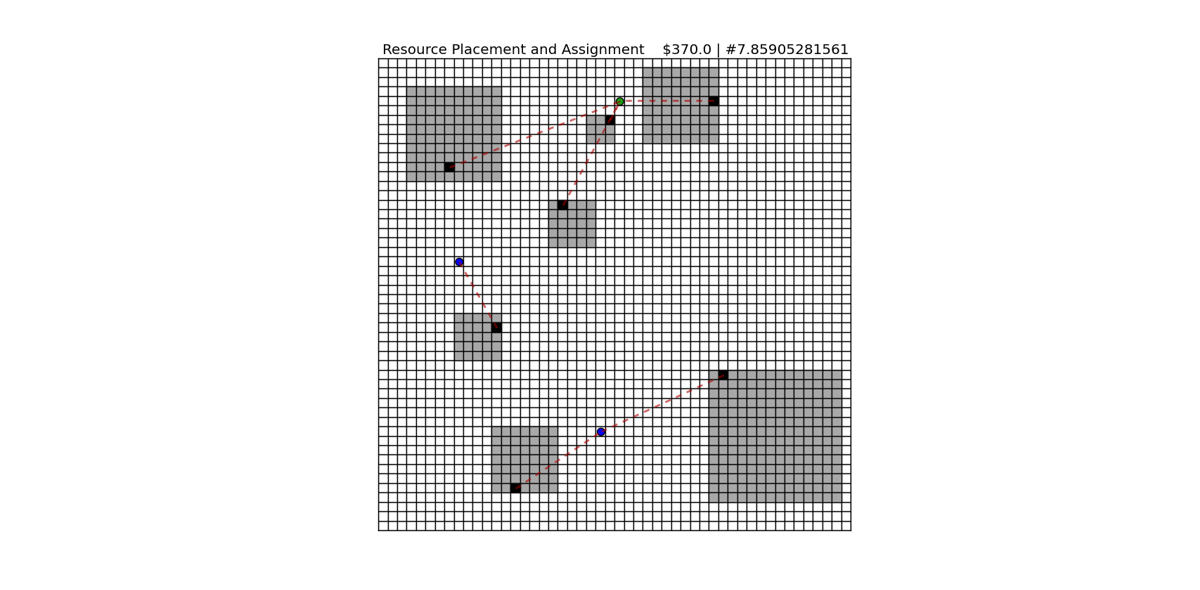
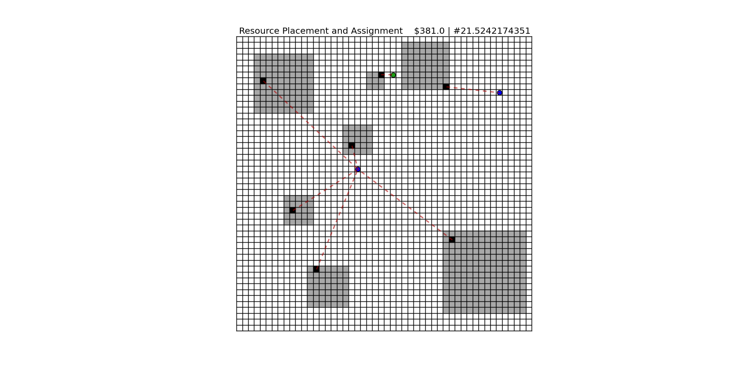
Appendix
Resource Placement and Assignment
IMAGE Results
Bi-Objective
Answers

Slide 28
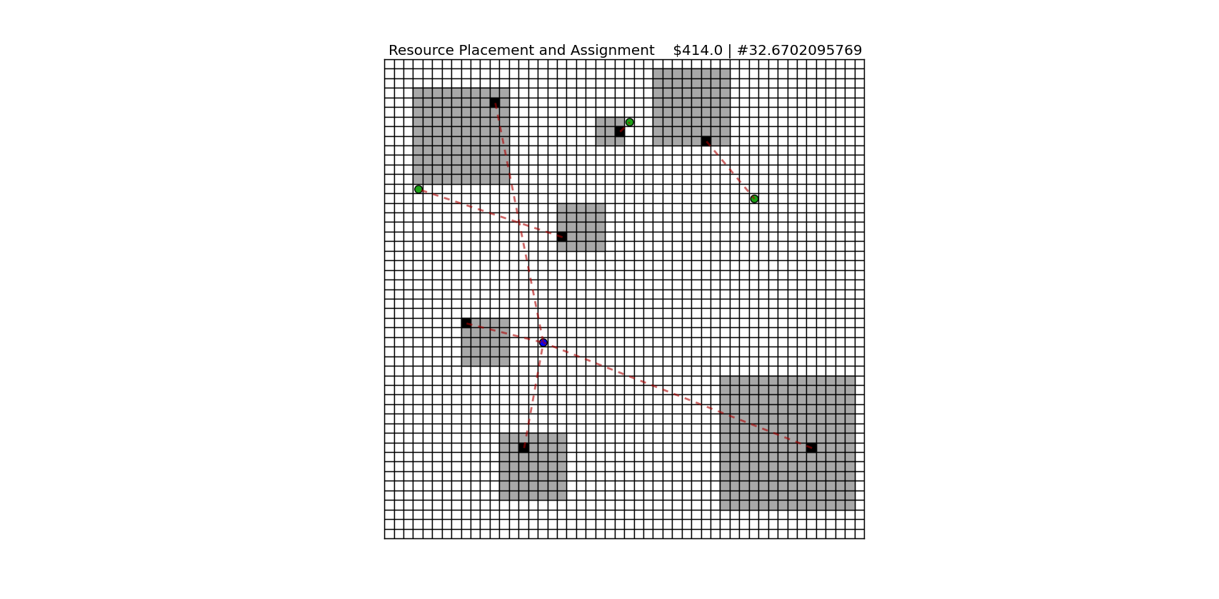
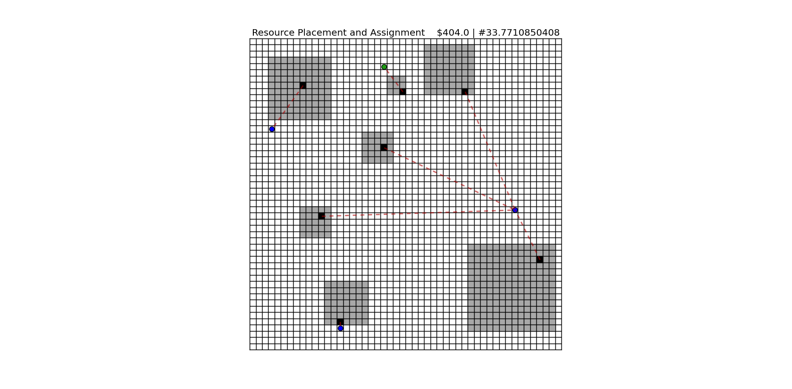
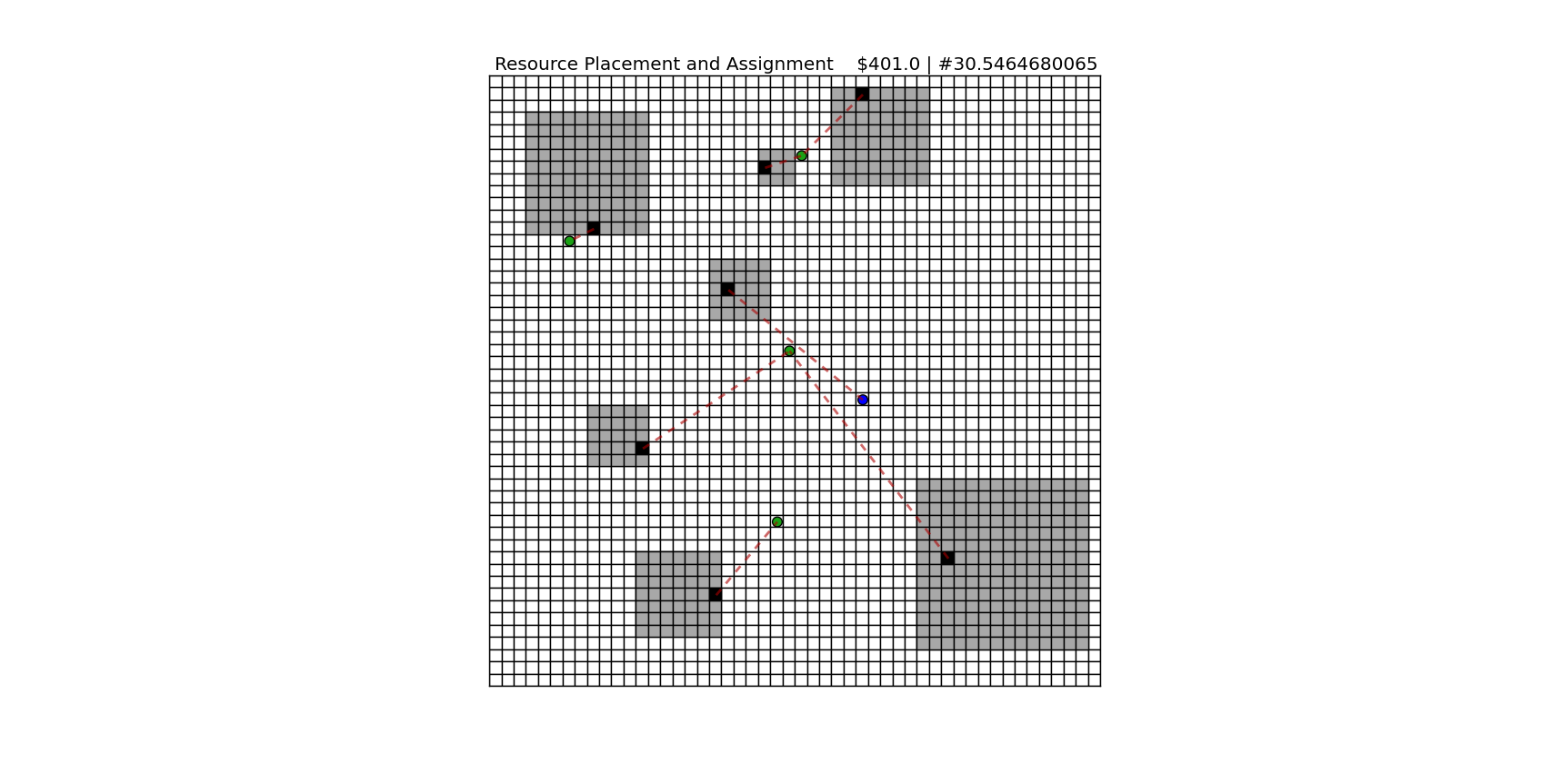
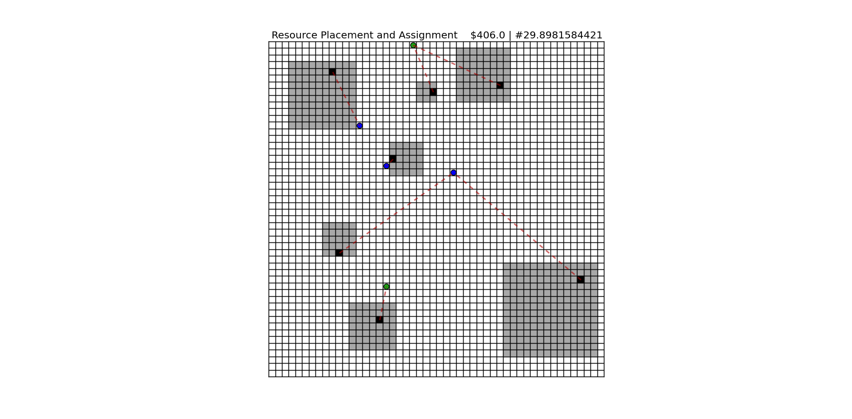
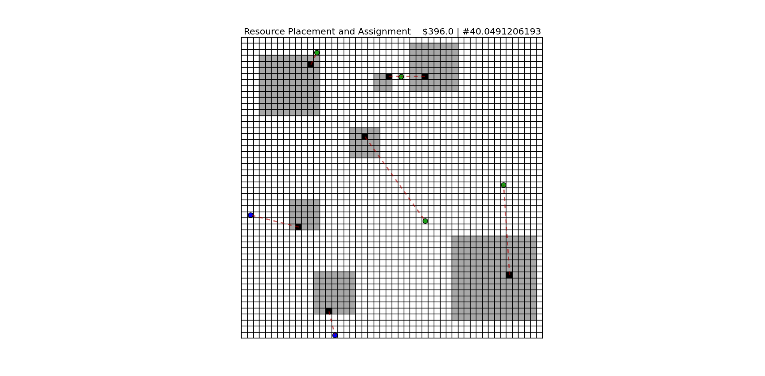
Appendix
Resource Placement
IMAGE Results
Bi-Objective
Answers

Slide 29
Appendix
Resource Placement and Assignment
Multiattribute Utility
Attributes
Utility Functions

Slide 30
Appendix
Resource Placement and Assignment
Questions
Fix after selection. Is it Valid? Mutation error = 60%
Should the problem be extended here with: “and others subjectives objectives (non-explict)”?
Bad answers for Prod (due to f2?) Is it acceptable?
Next Steps
World and Constraints?
Algorithm (nsga2 or SMS EMOA)?
Reference Point?
Votting (utility function)?
State of art (old and new)
Subjectivity, hidden or preferences?
Learning?
Which strategy: solution or decision?
(over or include?)
? What else?

